Slide 1
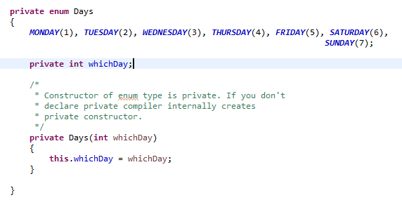
Java Enum
Enum can have fields, constructors and methods.
Can we create the instance of enum by new keyword?
No, because it contains private constructors only.
Can we have abstract method in enum?
Yes, we can have abstract methods and can provide the implementation of these methods.

